Slide 1
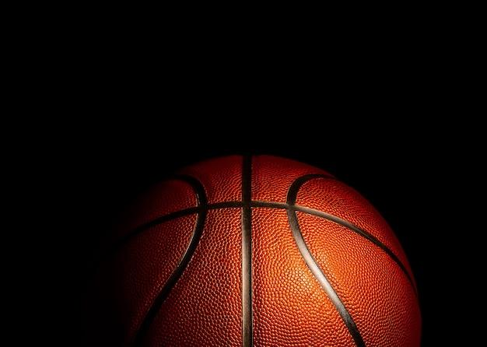
Bracket Trusters March Madness
March 4, 2023

Slide 2

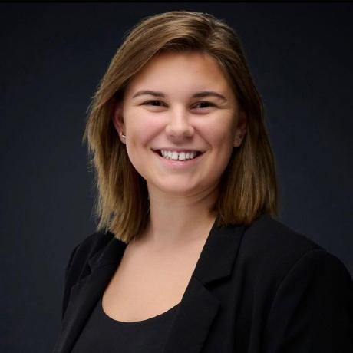

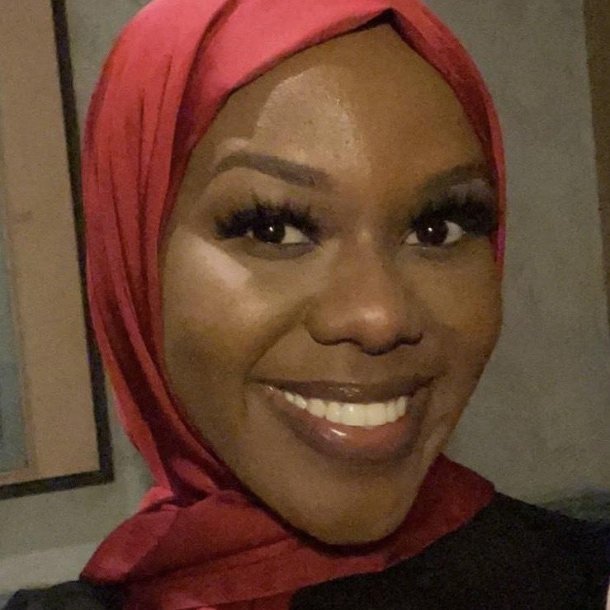

The Team
Ryan Marshall
Caroline Christy
Gardy Anger
Nasra Ahmed
Dylan jackson
Data Analyst
Data Analyst
Data Analyst
Data Visuals
Project Coordinator

Slide 3
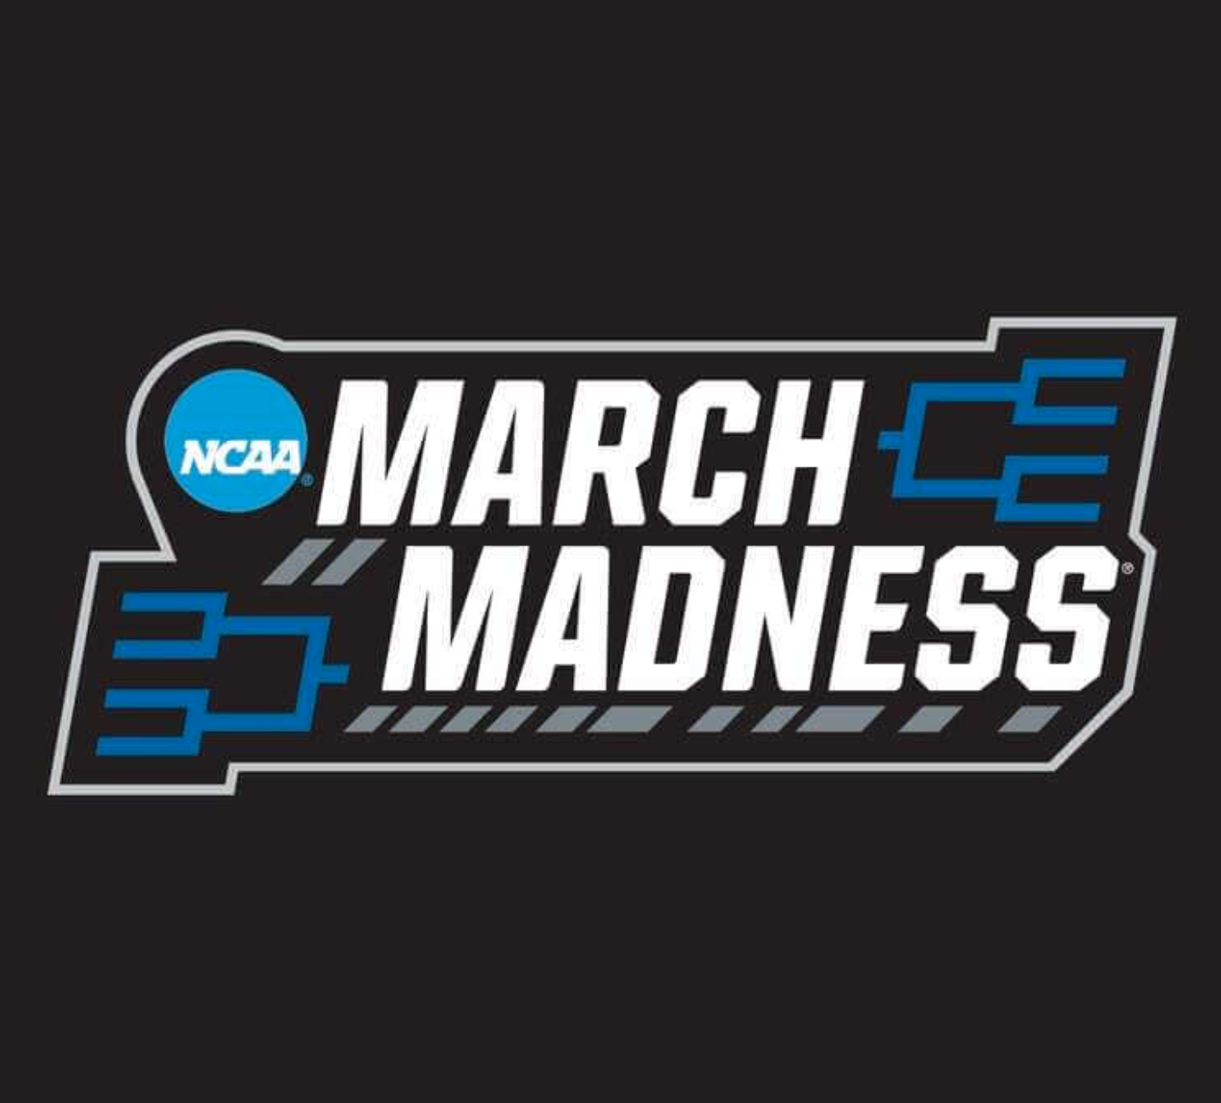
Project Overview
With March Madness around the corner, a lot of excitement comes from being able to predict some possible matchups, upsets, and even who is going to win it all.
While most fans rely heavily on their emotions and fanaticism to predict certain outcomes, this project uses machine learning to assist in predicting the 2023 bracket.

Slide 4
Data Sources
“Kaggle Competitions”
For the total competition.
“College Basketball Dataset”
For the 2013 through 2021 seasons.
“NCAAM March Madness”
For the year, score, round and seed from 1985 to 2021.
“NBA Machine Learning”
For Alexander Fayad NBA prediction algorithm.

Slide 5
Tools & Languages Used
Jupyter Notebook
JavaScript
HTML
Jupyter Notebook was our tool to visualize and clean our data.
We were also able to pull several visuals from our datasets.
JavaScript was the forefront for our front-end development.
We used HTML to display the data.

Slide 6
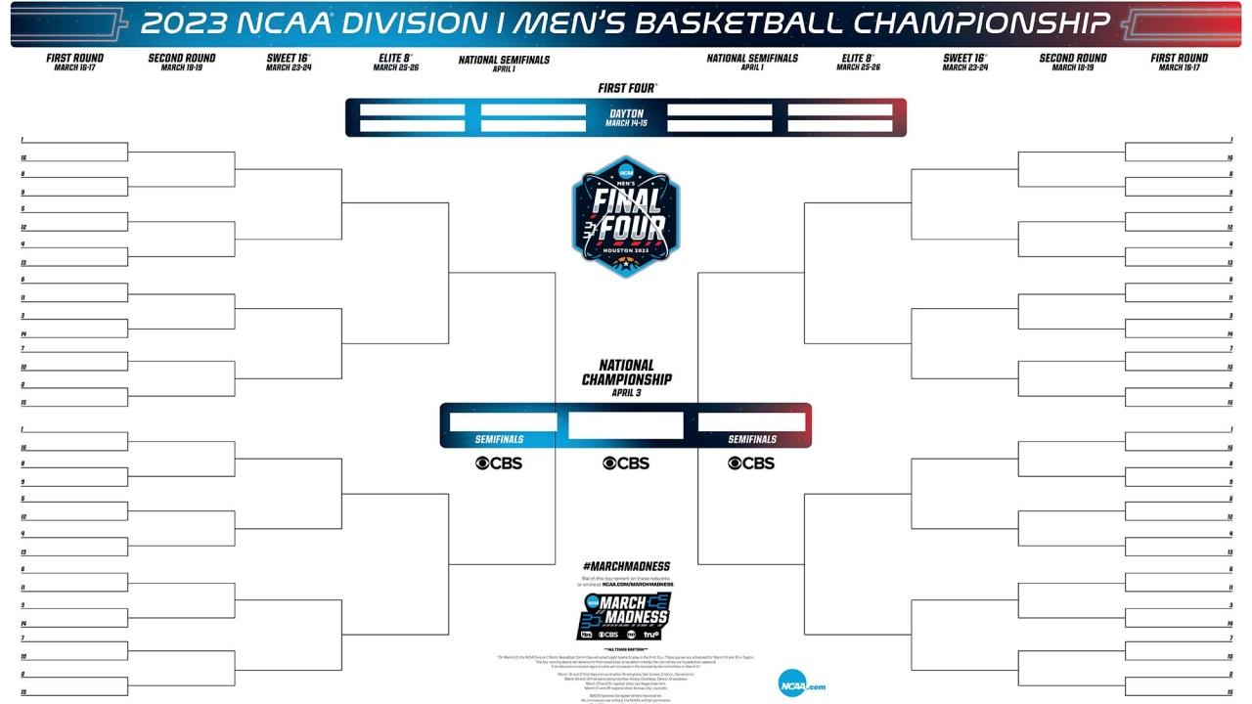
Limitations of Our Model
By using existing datasets we were able to best predict the final outcomes of each bracket.
Of course there are some limitations that need to be covered.
Due to things such as game bans, injuries, or sicknesses. Some players aren't always in each game. This can heavily affect a teams statistics so our datasets are fixed to a certain date.
We used the bracket from Joe Lunardi’s prediction on February 28th.

Slide 7
Model & Results
We used a logistic regression module.
We organized each matchup into 'Team1' versus 'Team2'
Our target column was 'Team1Wins', which had a value of '1' if Team 1 won the game and '0' if Team 2 won
Our model had a training data score of 0.778 and a test data score of 0.7388
The model seems to predict a lot of upsets. Out of the 32 games in the first round, the model has the lower-seeded team winning in 18 of these games.
There was a two-way tie for biggest upset with two of the #15 seeds beating the #2 seeds. (Eastern Washington beat Baylor and Vermont beat Kansas State)
The Final Four was Houston, Tennessee, Texas, and UCLA, with Tennessee and UCLA playing in the championship game.
Our model predicts UCLA as the 2023 NCAA tournament champion!

Slide 8
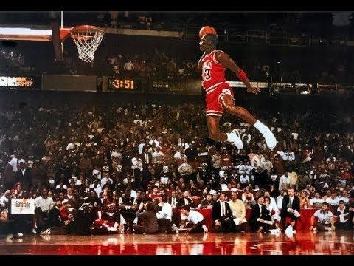
Visual Presentation

